Slide 1


DEVELOPMENT OF NOVEL PEPTIDE AND PEPTIDOMIMETIC LIGANDS FOR THE TREATMENT AND PREVENTION OF DISEASES
Victor J. Hruby Minying Cai
Regents Professor Research Professor
MCR Therapeutics, L.L.C.
Tucson, Arizona

Slide 2
INTRODUCTION-I
IMMEDIATE GOALS FOR MCR THERAPEUTICS, LLC
I. PRECLINICAL STUDIES OF MCR SELECTIVE LIGANDS
II. PRECLINICAL STUDIES FOR TREATMENT OF PAIN WITHOUT TOXICITIES OF CURRENT MEDICATIONS
III. EXAMINATION OF MULTIPLE DELIVERY SYSTEMS
IV. APPLICATION TO THE FDA FOR CLINICAL TRIALS
V. CLINICAL TRIALS WITHIN 2-4 YEARS

Slide 3
INTRODUCTION
I. Pain Is The Most Prevalent And Expensive Disease In The U.S. And The World, Costing More Than Cancer, Heart Disease And Diabetes Combined. Our Current OPIOID Epidemic Is Only A Small Portion Of The Problem.
II. Investment In Research & Development For New Modalities For Treating Pain Are A Small Fraction Of That For The Above Diseases.
III. MOST ASTONISHING – Though Several Laboratories Worldwide, Including Our Own Have Developed Novel Compounds For The Treatment Of Pain That DO NOT Have The Toxic Side Effects Of Current Drugs, Virtually None Have Had Clinical Trials.
WHY? How Can We Bridge The Gap?

Slide 4
GOAL
In This Brief Presentation, I Will Outline A Couple Of Examples of Compounds From Several Discoveries That Can Treat Acute, Prolonged AND Neuropathic Pain States That Do NOT Have The TOXICITIES And ADDICTION/TOLERANCE Properties Of Current Drugs
WILL YOU HELP?

Slide 5
OTHER MODALITIES AVAILABLE WITH NO OR GREATLY REDUCED TOXICITIES
I. Mu/Delta Agonist Ligands Of Three Different Structural Types
II. Mu Selective Agonists, Kappa Antagonist Bivalent Ligand
III. Mu/Delta Agonists, Melanocortin-1 Receptor Agonists

Slide 6
ENDOGENEOUS HUMAN OPIOID LIGANDS AND OPIOID TOXICITY
OPIOID LIGANDS ARE ACTIVE IN HUMANS EVERY DAY OF OUR LIVES. THEY ARE NONTOXIC.
THE ENDOGENOUS OPIOID LIGANDS ARE PEPTIDES - A. ENDORPHINS, B. ENKEPHALINS, C. DYNORPHINS
THE ENDOGENOUS OPIOID LIGANDS ARE RELATIVELY NON-SELECTIVE.
MOST OF OUR CURRENT DRUGS FOR PAIN ARE RECEPTOR/ENZYME SELECTIVE. MOST ARE QUITE TOXIC AND ARE NONPEPTIDES.
NATURE IS SMART (3.5 BILLION YEARS OF CHEMISTRY OF LIFE). WE SHOULD PAY MORE ATTENTION TO WHAT NATURE IS TELLING US.

Slide 7
EVIDENCE FOR UP-REGULATION OF NEUROPEPTIDES AND THEIR RECEPTORS
IN DEVELOPMENT OF PROLONGED
AND NEUROPATHIC PAIN FROM GENOMICS AND PROTEOMICS
Antibodies to PEPTIDE NEUROTRANSMITTERS That
Cause Pain Show Large Increases of Neurotransmitters
Released in Pain Pathways.
Antibodies to RECEPTORS Show Increased
Concentrations of Receptors in Spinal Pain Pathways.
Prolonged Treatment of Naive Animals with Morphine
Leads to Development of Neuropathic Pain – Also 1 and 2.
In Some Cases, Antagonists for These New Receptors
Can Block or Partially Block This Pain.

Slide 8
HYPOTHESIS
Molecules with high affinity and antagonist actions at CCK or NK-1 receptors, and high affinity and agonist actions at opioid receptors
■ Have enhanced activity in neuropathic pain states and in acute pain states
■ Have applicability for treatment of chronic pain without the development of tolerance
■ Have utility in individuals tolerant to the pain-relieving actions of opiates

Slide 9
DESIGN
OPIOID / NK-1 LIGANDS
Combination of Two Pharmacophores
Through Amino Acid Moiety Serving as
an Address Moiety for BOTH
Pharmacophores
H-Tyr-DAla-Gly-Phe--Phe--Pro-Leu-Trp-O-3,5-Bn(CF₃)₂
Opioid Pharmacophore
Address
Amino Acid
NK-1 pharmacophore
Yamamoto et al., J. Med. Chem., 50, 2779-2786 (2007).

Slide 10
MODIFICATION AT C-TERMINAL
TY005:
Tyr-DAla-Gly-Phe-Met-Pro-Leu-Trp-O-3,5-Bn(CF₃)₂
TY027:
Tyr-DAla-Gly-Phe-Met-Pro-Leu-Trp-NH-3,5-Bn(CF₃)₂
TY025:
Tyr-DAla-Gly-Phe-Met-Pro-Leu-Trp-NH-Bn
Modification at C-terminal:
  Critical activity difference at rat NK1 receptor
  Less substance P antagonist activity difference at guinea pig ileum (Species difference)
  Act as an “address region” for opioid activities
Expected activities in human
  Opioid activity: TY025 > TY027 > TY005
  SP antagonist activity: TY025 = TY027 > TY005

Slide 11
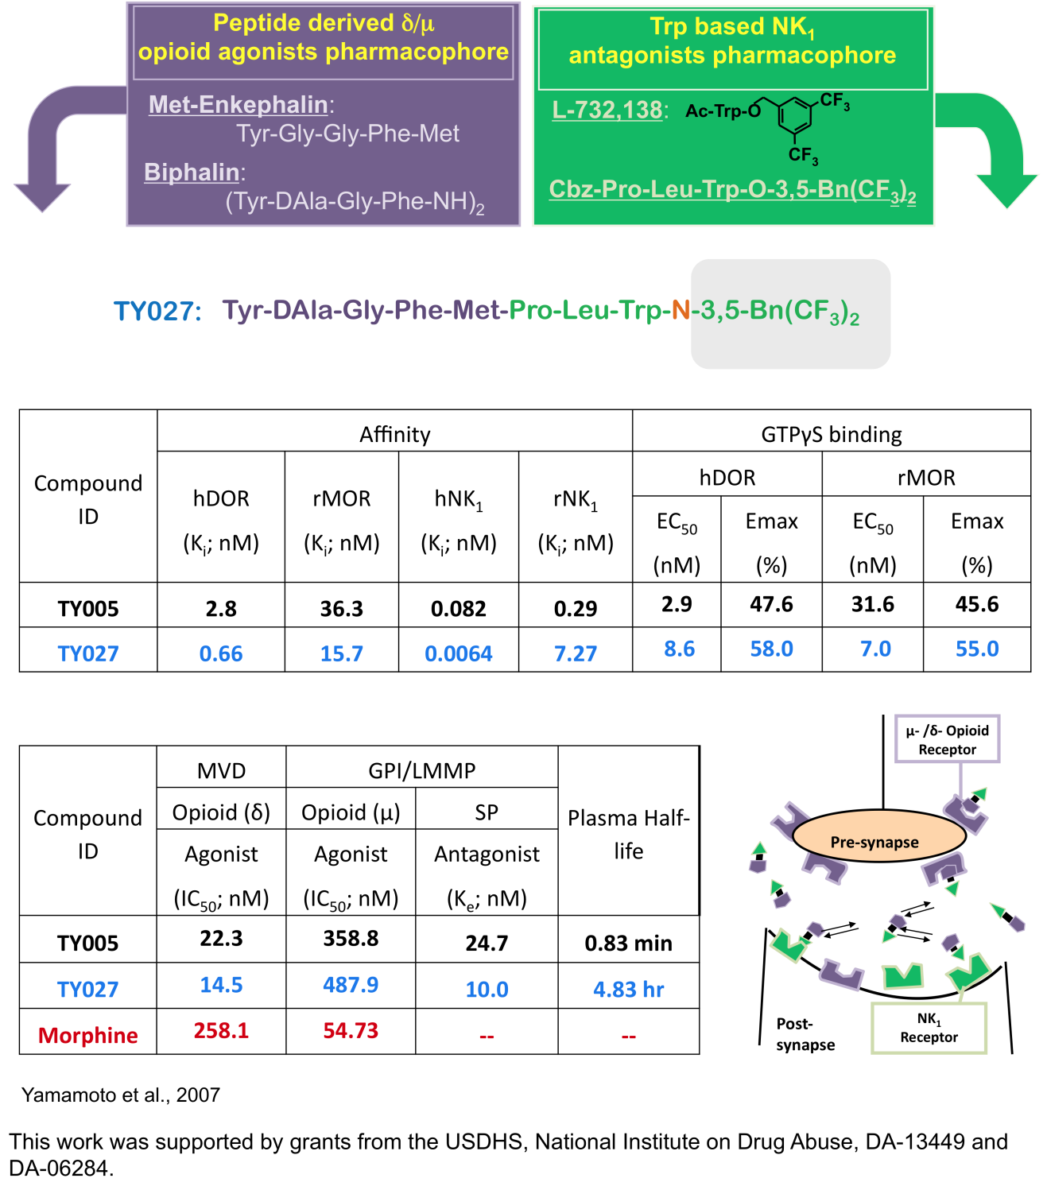
In Vitro Assays for Mu/Delta NK1 Agonist Antagonist Ligands
Largent-Milnes et al., BJP, 161, 2010
This work was supported by grants from the USDHS, National Institute on Drug Abuse, DA-13449 and DA-06284.

Slide 12
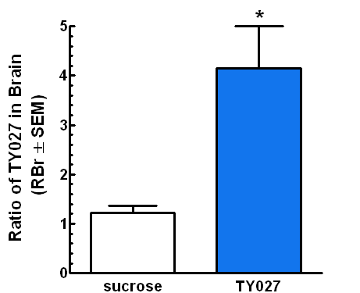

TY027 CROSSES THE BBB
100
10
in
1
K
0.1

Slide 13
INTRAVENOUS (I.V.) TY 027 ATTENUATES
NERVE INJURY-INDUCED TACTILE AND THERMAL SENSITIVITIES

Slide 14
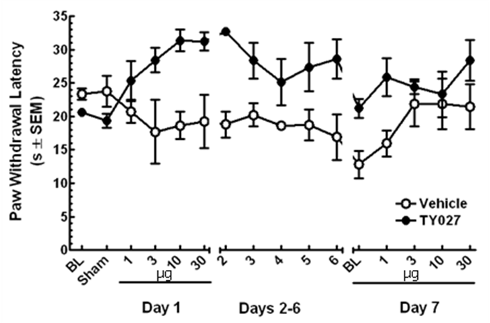
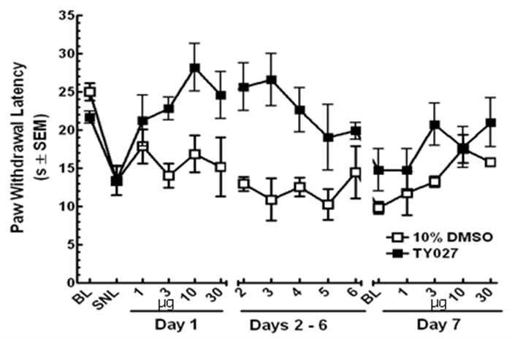
TY027 MAINTAINS EFFICACY FOLLOWING CHRONIC ADMINISTRATION
A ) Sham Operated-Ipsilateral
B) Thermal
C) Tactile
D) Sham - Contralateral

Slide 15
TY027 DOES NOT SHOW CONDITION
PLACE PREFERENCE
A) i.p.
B) Systematic

Slide 16
TY027 DOES NOT ALTER GI TRANSIT
80
6
60
% of Total ⁵¹Cr in Small
Intestine (± SEM)
4
40
Geometric Center
(± SEM)
*
*
20
2
0
0
Vehicle
MS
TY027
Vehicle
MS
TY027

Slide 17
OTHER MODALITIES AVAILABLE WITH NO OR GREATLY REDUCED TOXICITIES
I. Mu/Delta Agonist Ligands Of Three Different Structural Types. No Toxicities
II. Mu Selective Agonists, Kappa Antagonist Bivalent Ligand
III. Mu/Delta Agonists, Melanocortin-1 Receptor Agonists

Slide 18
Melanocortin Ligands for Health and Diseases

Slide 19


About MCR Therapeutics
Founder Dr. Victor J. Hruby
Regents Professor of Chemistry & Biochemistry
Professor of Pharmacology, Neurosciences, Bio5
Member of Arizona Cancer Center, University of Arizona
World Leaders of peptide drug design and discovery.
Over a thousand publications and numerous patents
Founder of Selectides (Sanofi in Tucson) and many other start-ups
Collaborators
Merck, Sanofi, Roches, Poly-Peptide, Peptide Scientific
Worldwide Professors
Pierre Rivière, Ph.D.
Tomi Sawyer, Ph.D.
Founder Dr. Minying Cai
Research Professor Chemistry & Biochemistry, BIO5
Member of Arizona Cancer Center, University of Arizona
World Leaders of peptide drug design and discovery
27 years peptide drug design and discovery and
Over one hundred publications and numerous patents
Collaborators
Merck
Worldwide Professors

Slide 20
Vision for MCR Therapeutics
Independent Peptide Drug Discovery and Development Team, operating like a biotech
Privileged scientific & business partnership with The University of Arizona and Private Enterprise partnerships
Integrated R&D ecosystem, early-stage involvement of biotech, pharma & investors
Jointly accelerate translation of new ideas into innovative medicines

Slide 21
Drug Discoveries of MCR Therapeutics
MCR Therapeutics
Academia
Start-Ups
Investors
Industry

Slide 22
5 Years Goals & Timeline
R&D 4-6 new drug discovery programs initiated over 1-3 years
2-4 NMEs in total identified over 5 years
One (/first) NME entering preclinical development within 1 year
One (/first) IND filed within 2-3 years
One (/first) Phase I completed within 2-3 years
 | Year 1 | Year 2 | Year 3 | Year 4 | Year 5
1
2
3
4
5
6
Preclin. Dev
Phase 1
Phase 2

Slide 23
Immediate Goals for MCR Therapeutics LLC
Preclinical studies of MCR selective ligands.
Examination of delivery systems.
Application to FDA for clinical trials.
Clinical trials within 2-4 years.

Slide 24
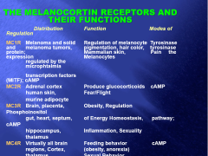
THE MELANOCORTIN RECEPTORS AND THEIR FUNCTIONS
Distribution Function Modes of Regulation
MC1R Melanoma and solid Regulation of melanocyte Tyrosinase and melanoma tumors, pigmentation, hair color, tyrosinase protein; Mammalian skin, Pain the expression Melanocytes regulated by the microphtalmia
transcription factors (MITF); cAMP
MC2R Adrenal cortex Produce glucocorticoids cAMP
human skin, Fear/Flight
murine adipocyte
MC3R Brain, placenta, Obesity, Regulation Phosphoinositol
gut, heart, septum, of Energy Homeostasis, pathway; cAMP
hippocampus, Inflammation, Sexuality
thalamus
MC4R Virtually all brain Feeding behavior cAMP
regions, Cortex, (obesity, anorexia)
thalamus, Sexual Behavior
hypothalamus Neuronal Function
brainstem, spinal cord
MC5R Peripheral tissue Thermo-regulation Jak/STAT; cAMP
Brain Subaccious gland secretion

Slide 25
MAJOR POTENTIAL APPLICATIONS FOR LIGANDS SELECTIVE FOR MELANOCORTIN RECEPTORS
1. Pigmentation Without Sun
  A. Prevention of Melanoma and Other Skin Cancers
  B. Pigmentary Disorders
  Treatment of Melanoma Cancer
  Stress Related Disorders
  Feeding Behavior
  A. Obesity
  B. Anorexia
  Sexual Behavior and Dysfunction
  Neurodegenerative Diseases
  Immune Response
  AND MANY OTHERS: We Now Have Stable, Bioavailable, Receptor Selective Agonist and Antagonist Ligands For MC1R, MC3R, MC4R and MC5R

Slide 26
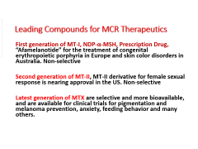
Leading Compounds for MCR Therapeutics
First generation of MT-I, NDP-α-MSH, Prescription Drug, “Afamelanotide” for the treatment of congenital erythropoietic porphyria in Europe and skin color disorders in Australia. Non-selective
Second generation of MT-II, MT-II derivative for female sexual response is nearing approval in the US. Non-selective
Latest generation of MTX are selective and more bioavailable, and are available for clinical trials for pigmentation and melanoma prevention, anxiety, feeding behavior and many others.

Slide 27
Applications for Melanoma Prevention
Melanoma is the most dangerous form of skin cancer. In 2016, there is an estimated 73,870 new cases of melanoma, with an estimated of 10,130 deaths in the U. S. alone. Exposure to UV radiation is the primary risk factor for melanoma. Skin pigmentation, on the other hand, is an effective protection against melanoma. Melanocytes can produce melanin, which is able to dissipate over 99.9% of UV radiation. The strong correlation between skin pigmentation and melanoma risk is also evidenced by the fact that in the U.S., Caucasians have 20-30 times higher chances of getting melanoma than Asians and Blacks. Current efforts seek to prevent UV damage to human skin, which in many cases leads to melanoma and other skin cancers. As a result, inducing skin pigmentation without UV exposure is considered an effective way to prevent UV induced melanoma.

Slide 28
MT I AND MT II CAN PIGMENT HUMANS WITHOUT
SUN AND PROTECT DNA FROM UV DAMAGE
Human clinical trials have been run at the UofA on MT-I and MT-II to examine pigmentation effects
2. Pigmentation occurs throughout the body
U.V. radiation damage of DNA is reduced by MT-I and MT-II induced pigmentation
References
N Levine, SN Sheftel, T Eytan, RT Dorr, ME Hadley, JC Weinrach, GA Ertl, K Toth, VJ Hruby. J. Am. Med.
Assoc., 266, 2730-2736 (1991).
ME Hadley, VJ Hruby, SD Sharma, RT Dorr, N Levine. Ann. New York Acad. Sci., 680, 424-439 (1993).
ME Hadley, SD Sharma, VJ Hruby. Peptides: Biology and Chemistry, Proc. of the 1992 Chinese Peptide
Symposium, Y Du, JP Tam and Y Zhang, Eds.,ESCOM Sci. Pub., Leiden, 53-56 (1993).
SO Ugwu, J Blanchard, RT Dorr, N Levine, C Brooks, ME Hadley, M Aickin, VJ Hruby. Biopharm. Drug Disposit.,
18, 259-269 (1997).
J Jiang, SD Sharma, S Nakamura, JY Lai, JL Fink, VJ Hruby, ME Hadley. Pigment Cell Res., 8, 314-323 (1995).
RT Dorr, R Lines, N Levine, C Brooks, L Xiang, VJ Hruby, ME Hadley. Life Sciences, 58, 1777-1784 (1996).
SD Sharma, J Jiang, ME Hadley, DL Bentley, VJ Hruby. Proc. Natl. Acad. Sci. USA, 93, 13715-13720 (1996).
ME Hadley, VJ Hruby, J Blanchard, RT Dorr, N Levine, BV Dawson, F Al-Obeidi, TK Sawyer. Integration of
Pharmaceutical Discovery and Development: Case Studies, R Borchardt, Ed., Plenum Press,NY,575-595 (1998).

Slide 29
Melanoma Prevention
Seeking effect treatments of melanoma is very hot in current era of science and technology. However, prevention of melanoma has been neglected.
MCR Therapeutics first successfully developed a natural amino acids made peptide, [Leu³, Leu⁷, Phe⁸]-γ-MSH-NH₂, which is a potent selective hMC1R agonist. It can be used effectively for melanoma prevention without any of side effects. Several other MC1R selective ligands invented and patented.

Slide 30
[Leu³, Leu⁷, Phe⁸]-γ-MSH-NH₂ Binding with hMC1R
J. Med. Chem., 2017, 60 (22), pp 9320–9329

Slide 31
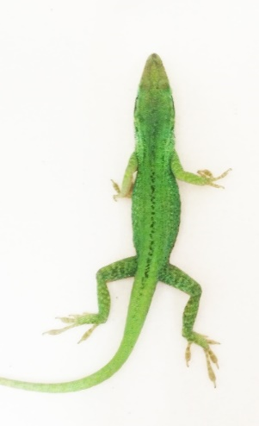
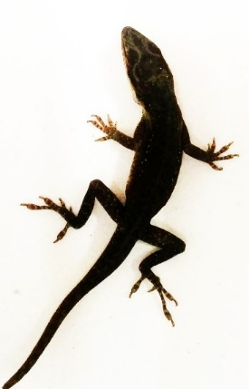
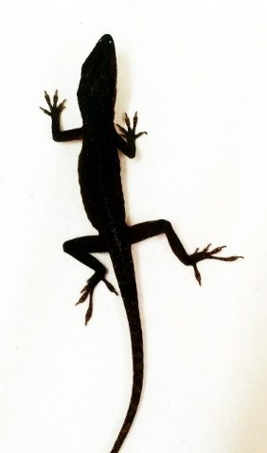
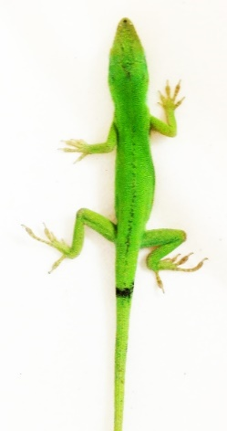
<1min
>14 days
Melanotan I (NDP-α-MSH or Scenesse, prescription drug, nonselective hMCRs agonist is currently used for the skin color disorder) induce pigmentation on the Anolis carolinensis. Left, before injection; Right, after injection in 1 min.
<1min
<1 days
Newly developed [Leu³, Leu⁷, Phe⁸]-γ-MSH-NH₂ (hMC1R selective agonist with less side effect) induce pigmentation on the Anolis carolinensis Left, before injection; Right, after injection in 1 min.

Slide 32
Compelling Next-Generation MCR Therapeutics (cont’d)
MC1R selective antagonists for skin lightening (Asian markets)
Advantage: topical application, hMC1R selective antagonist
Next generation MC1R selective peptide antagonists for unique MC1R applications

Slide 33
Target Market
Specific Estimates of Markets:
Tanning Market: This involves millions of people, especially white people who spend billions of dollars on tanning salons, "going to the beach and resorts" etc. to get a tan etc. It is likely that many of these people would prefer to obtain a tan without the costs of these methods, protect themselves against sun burns, melanoma cancer etc. and at the same time get a nice tan to protect themselves against sun burns, melanoma cancer, etc. if we can keep the cost reasonable. Billions of dollars are involved and spent now on these activities.
Melanoma Cancer: In terms of melanoma cancer which is then fastest growing cancer worldwide and especially in places like Arizona, so early detection and treatment of melanoma cancer also may be a billion dollar business. Lightening market: This involves millions of people, especially in Asia including Japan, Korea, China who spend billions of dollars on lightening their skin .with cosmetics. It seems a very large billion dollar market awaits development of such an agent.
Lightening Market: This involves millions of people, especially in Asia including Japan, Korea, and China that spending billions of dollars on cosmetics to lighten their skin. Thus it appears that a billion dollar market awaits development of such a product.

Slide 34
MCR Agonist & Antagonist Design Strategy
Ligand pharmacophore model and analog design
Truncation studies, Ala scan, D-amino acid scans, macrocyclization
Amphiphilic and topological properties; lipophilicity
Biophysical and computational design
NMR, computer-aided drug design, backbone/Chi space considerations, proven models for the MC1R, MC3R, MC4R & MC5R
Receptor selectivity based design
Chimeric receptors, single/multiple site mutagenesis, molecular docking
Biased signaling properties
cAMP and/or other non-cAMP pathways, beta-arrestin
Blood brain barrier (BBB)
Lipophilicity, glycosylation, N-methylation
Drug delivery
Transdermal, intranasal, oral, I.P. , I. V.
Focus on optimizing for desired MCR selectivity and functional activity profile

Slide 35
MCR Agonist & Antagonist Design Strategy (cont’d)
Transfection Cell Line Development for Assay System
• First transfected melanocortin cell lines which are used worldwide
GPCR Functional Assays
Ligand Binding
cAMP
IP3
Ca²⁺
Others
Signal detection (and interpretation) system
Kinase Assays
Imaging Developments
Multimodal imaging agents (fluorescence imaging, MRI, PET)
Focus on optimizing for desired MCR selectivity and functional activity profile

Slide 36
Selective MCR Agonists & Antagonists: MCR Expertise
α-MSH
NDP-α-MSH
(MT-I)
Cyclic Melanotropins
(MT-II)
Peptidomimetics
& Nonpeptides
Selective MCR ligands for MC1R, MC3R, MC4R and MC5R
• Agonists, Antagonists, Inverse-agonists
• Orthosteric, allosteric
• Peptide, peptidomimetic, nonpeptide
Potent, Selective, Bioavailable
More than 500 MCR scientific publications and patents/filings • Science, Nature, PNAS, JACS, JPET, J Biol Chem., and J Med Chem!

Slide 37
Emerging Academic and Biotech Studies Exemplify Compelling MCR Drug Development Opportunities to Advance Superior Peptide and Nonpeptide Modalities
MCR biased signaling implicating potential for receptor/functional selectivity
  AP1189 (nonpeptide) effects MC1R and MC3R activation of Erk1/2 but not cAMP
  MTII (peptide) effects MC4R driven greater obesity in Gq/11 knockout mice
  THIQ (nonpeptide) vs MTII effect unique MCR4 driven Ca²⁺signaling profiles
Preclinical studies implicating MCR agonists having therapeutic potential for specific disease indications (receptor/functional selectivity?)
  MC4R/MC3R targeted agonist for neurodegenerative disease
  MC5R targeted agonist for stress related disorders
  MC1R targeted agonist for cancer, pain, IBS
Clinical studies on MCR peptide agonists (receptor/functional selectivity?)
  Rhythm (Setmelanotide; obesity)
  Palatin (Bremelanotide; sexual dysfunction)
  Clinuvel (Scenesse®; EPP and related skin disorders)

Slide 38
Evaluation of Novel Peptide and Nonpeptide Modalities For Novel Medical Applications
Evaluation of MC4R selective agonists for neurodegenerative disease (e.g., Alzheimer’s disease)
  Identify MCR4 selective modality that crosses the BBB
Explore use of MC5R selective agonist for the treatment of stress related diseases
  Identify MC5R selective modality that crosses the BBB
Explore use of MC1R selective agonist for the treatment of cancer (melanoma) and pain therapy
  Identify MC1R selective modality that crosses the BBB
Focus on optimizing for desired MCR selectivity and functional activity profile!

Slide 39
hMC4R Peptide Application Neurodegenerative Diseases
MTII conjugates and selective hMC4R ligands are used to study the neurodegenerative diseases
The initial results show the hMC4R selective ligand does play an important role for the Regeneration/Degeneration. We are working on the statistics and ANOVA for the behavior study with our collaborators.
UA17-016 Patent Disclosure

Slide 40
hMC1R Ligand Application to Pain and Circulation
cyclo-[(CH₂)₃CO-Gly¹-His²-D-Phe³-Arg⁴-D-Trp⁵-Cys(S-)⁶]-Asp⁷-Arg⁸-Phe⁹-Gly¹⁰-NH₂
Melanocortin 1 Receptor Signaling Regulates Cholesterol Transport in Macrophages Circulation 2017, 136,1,83-97
α-Melanocyte-stimulating hormone regulates vascular NO availability and protects against endothelial dysfunction. Cardiovascular Research 2013, 97(2), 360-368.
Sex-specific Mediation of Opioid-induced Hyperalgesia by the Melanocortin-1 Receptor. Anesthesiology 2009, Volume Date 2010, 112(1), 181-188.

Slide 41
Concluding Remarks
The Potential Applications Of Melanotropin Ligands To Health And Disease Are Enormous
Several Of Our Peptides And Peptidomimetics Are Ready For Clinical Trials
MC1R Ligands Are Well Developed For Clinical Applications
1. Tanning (Pigmentation) Without Sun – Replace Tanning Salons, Etc. And Prevent Skin Cancer
2. Multimodal MC1R Ligands Are Developed For Melanoma Cancer Detection
3. Treatment Of Cancer – Selective Ligands
Excellent Ligands Available For Sexual Function, Feeding Behavior, Neurodegenerative Diseases, Stress and Inflammation

